Slide 1
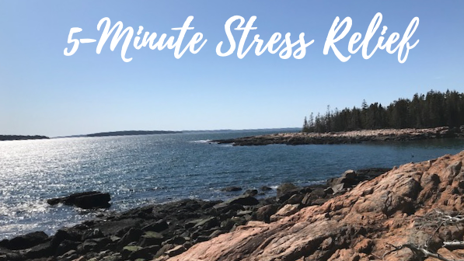
Part 5
The Healing Power of Qigong

Slide 2
Qigong
Qi: life force energy
Gong: work, cultivation
Qigong: “the art of cultivating life force energy”
“Chinese Yoga”
Grandmother of Tai Chi, Kung Fu – very ancient art

Slide 3
Qi from an Eastern Perspective
Qi= life force energy
The energy is all around us and in everything
Qi circulates in our body through channels or meridians
We can harness this Qi (energy) for self healing with Qigong
Disease: blockages in the channels that we need to open in order to heal

Slide 4
Qi from a Western Perspective
Quantum physics: particle vs wave (visible body vs energy); e.g. our heart and brain have electromagnetic fields
Healing results from creating the right chemicals and their unimpeded FLOW
Promote FLOW with moving meditation in Qigong
Energy keeps us alive (driving all bodily functions, through neurotransmitters, enzymes, electrochemical reactions etc.)

Slide 5
What Blocks Our Energy Flow?
Poor diet
Lack of exercise
Lack of social support
Toxins: smoking, alcohol, drugs
Physical blockages e. g. arthritis, coronary plaque
Negative emotions (mental emotional blockages)

Slide 6
The Blockage Wheel From Flowing Zen by Anthony Korahais

Slide 7
How Do We Unblock?
Healthy diet
Exercise
Positive mindset
qigong

Slide 8
from Flowing Zen by Anthony Korahais
Both the theory of epigenetics and the theory of Qi agree that we can exert tremendous influence over our genes, our vitality, our Qi, and our life by altering our lifestyle.
Even our beliefs seem to alter genetic expression. (Bruce Lipton Biology of Belief)

Slide 9
Quotes from Anthony Korahais -Flowing Zen
Qigong is more than just a series of movements
It's a comprehensive mind-body-spirit practice that improves mental and physical health by integrating posture, movement, breathwork, vocalization, and focused intent.
The flowing, meditative movements, coordinated with breath control, can foster a sense of inner calm and balance, aiding in stress relief and pain management.

Slide 10
Recent Neuroscience Study Results
In a 2021 systematic review of 15 studies exploring the effect on brain structure and function, Qigong (and other movement meditations like yoga) “mainly induced structural changes in the insula and cingulate cortex” which are the key nodes of our Salience Network.
This is our awareness center and when stimulated, it helps to balance other key networks in our brain.
This means that Qigong (or yoga) is actually MORE effective than other therapies for lowering stress, reducing anxiety, and building emotional resilience to future traumatic experiences.

Slide 11
(Continued from) Flowing Zen
Qigong is arguably the single best way to influence our genes and our vitality.
In fact, if we do only one thing to improve our vitality, Qigong is the way to go.
This is why Anthony Korahais always tells students to add a daily Qigong habit before trying to make other lifestyle changes.
“Start with the best!”

Slide 12
Healing Occurs In The Zone
QIGONG: Meditative movement
Repetitive movement in a MEDITative state
Healing occurs best in the zone

Slide 13
Most Important Elements for Effective Qigong Practice
Being “in the zone” of mindfulness and peace (start the session with it)
Creating focus and relaxation from the start
Big “Sigh of relief” always useful (body and vagus nerve relax instantly)
Performing the movements mindfully, slowly
Enjoy yourself!

Slide 14
A Few Exercises to Feel Qi
Shaking
West: therapeutic shaking (trauma treatment)
East: Shaking the Tree (awakens Qi)
Slow Stretch/reset
West: Pandiculation
East: most exercises are slow, coordinated with breath
Humming
West: sound therapy; binaural beats
East: healing sounds to target certain organs/emotions
Smiling
East: inner smile healing meditation
West: oxytocin, endorphins

Slide 15
Going Forward
5 Minute Stress Relief will continue on Mondays at noon on Teams
Very helpful for quick energy reset
as of June 2023 Elizabeth Clayton will lead the class under my mentorship
For sustained healing: a daily practice of at least 15 minutes in a mindfully meditative state

Slide 16
Teachers/Resources for Ongoing Practice
Anthony Korahais: Flowing Zen (book on Amazon), Flowing Zen - Flowing Zen (blog/site)- my favorite!
Lee Holden: YouTube; classes and free 30 day challenge: Online Programs - Holden QiGong
Nick Loffree: YouTube; some classes on his site Nick Loffree | Bioenergetic Health
Mimi Kuo-Deemer: YouTube; affordable classes Self-paced Courses - MIMI KUO-DEEMER (mkdeemer.com)
Jeffrey Chand: YouTube; website Qigong for Vitality - Feel Your Best With A Simple Qigong Practice

