Slide 1
4: Body, Breath, Mind

Slide 2
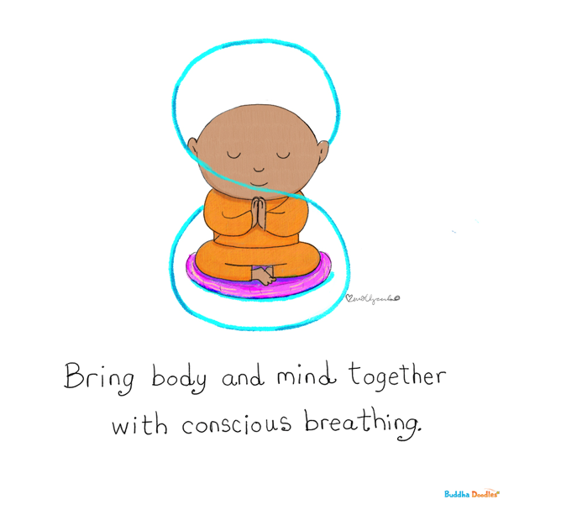

Slide 3
Fundamentals of Qigong Moving Meditation

Slide 4
Qigong: “Chinese Yoga”
The “grandmother” of Tai Chi; originates in China
There are over 7000 styles in the world, practiced by millions of people
It is the main health exercise used in China for centuries
Slow moving (or static) meditation and breathing
Qi or Chi (“chee”): “life force” energy (electromagnetic energy in all living things)
Gong: “work” (or “cultivation”) or even “play”

Slide 5
Daily Practice = Daily Maintenance

Slide 6
3 Fundamental Elements
Adjusting the body
Adjusting the breath
Adjusting the mind

Slide 7
1. Adjusting the Body

Slide 8
RELAXED upright posture Feet hip- or shoulder width apart Chin tucked in, top of head upright Spine straight (“string of pearls”) Slight pelvic tilt (to point tailbone to the ground) Arms hang naturally by the sides Knees are slightly bent Forehead, jaw, shoulders relaxed Fingers straight but relaxed No joints are “locked” Slight smile

Slide 9
2. Adjusting the Breath
LSD (long, slow, deep) or SLEDS (slow, long, even, deep, soft)
Diaphragmatic breath (“Belly breath”)
The breath is the “handle” for the moving meditation – improved focus and relaxation
Vagus nerve reset is the result
The SIGH of relief – quickest reset!
IN through the nose, OUT through the mouth

Slide 10
3. Adjusting the Mind
Mindfulness – be in the present moment
SMILE
May close eyes, FOCUS on the movement and breath, LET GO of worries
ENJOY the practice
Calmness as a result

Slide 11
Shortcut to Adjusting Body/Breath/Mind
Body: Stand upright and relaxed
Breath: Sigh of relief
Mind: Smile & be present

Slide 12
Elements of Practice

Slide 13
6 Phases
2 Adjusting the body (posture), breath and mind
3 Moving meditation proper- can be sitting if needed
4 Meditative centering in standing/sitting
5 Massage/tapping to exit the meditative state and stimulate blood flow
6 End with recentering/closing/gratitude
1 Opening: Bouncing/shaking (or vigorous walking)

Slide 14
Don’t Forget!
Before practice, check in and evaluate current state
SMILE
RELAX
ENJOY yourself
At the end, check in and evaluate current state after practice
Focus on the body and breath = present moment

Slide 15
SAFETY FIRST
Everything should feel COMFORTABLE
No overachieving
Listen to your body
Don’t overstretch or overbend
Bend knees safely
“Butcher the form”

Slide 16
Caution
There ARE 7000 styles of Qigong out there
There is a bit of a jungle out there too
Not all teachers are good or nice
Not all online or in person schools or YouTube Videos are user friendly
Generally Western teachers are a better bet
Books or YouTube videos even if good don’t give you access to the teacher

Slide 17
Recommended Reading
Flowing Zen by Anthony Korahais (one of my teachers –since 2018)
Available on Amazon
Soon also as audiobook
Links to videos – the first qigong book to do so
Great explanations – no weirdness
He does have an online academy

Slide 18
Today’s Movements (Phase 3)
Lifting the Spirit (Supporting the Heavens)
Punching with Fiery Eyes
Fireworks
Separating Heaven and Earth (Plucking Stars)
The Accordion (Breathing of the Universe)
Carrying the Moon

Slide 19
-Thank you- Don’t go away! Practice to follow

